Slide 1
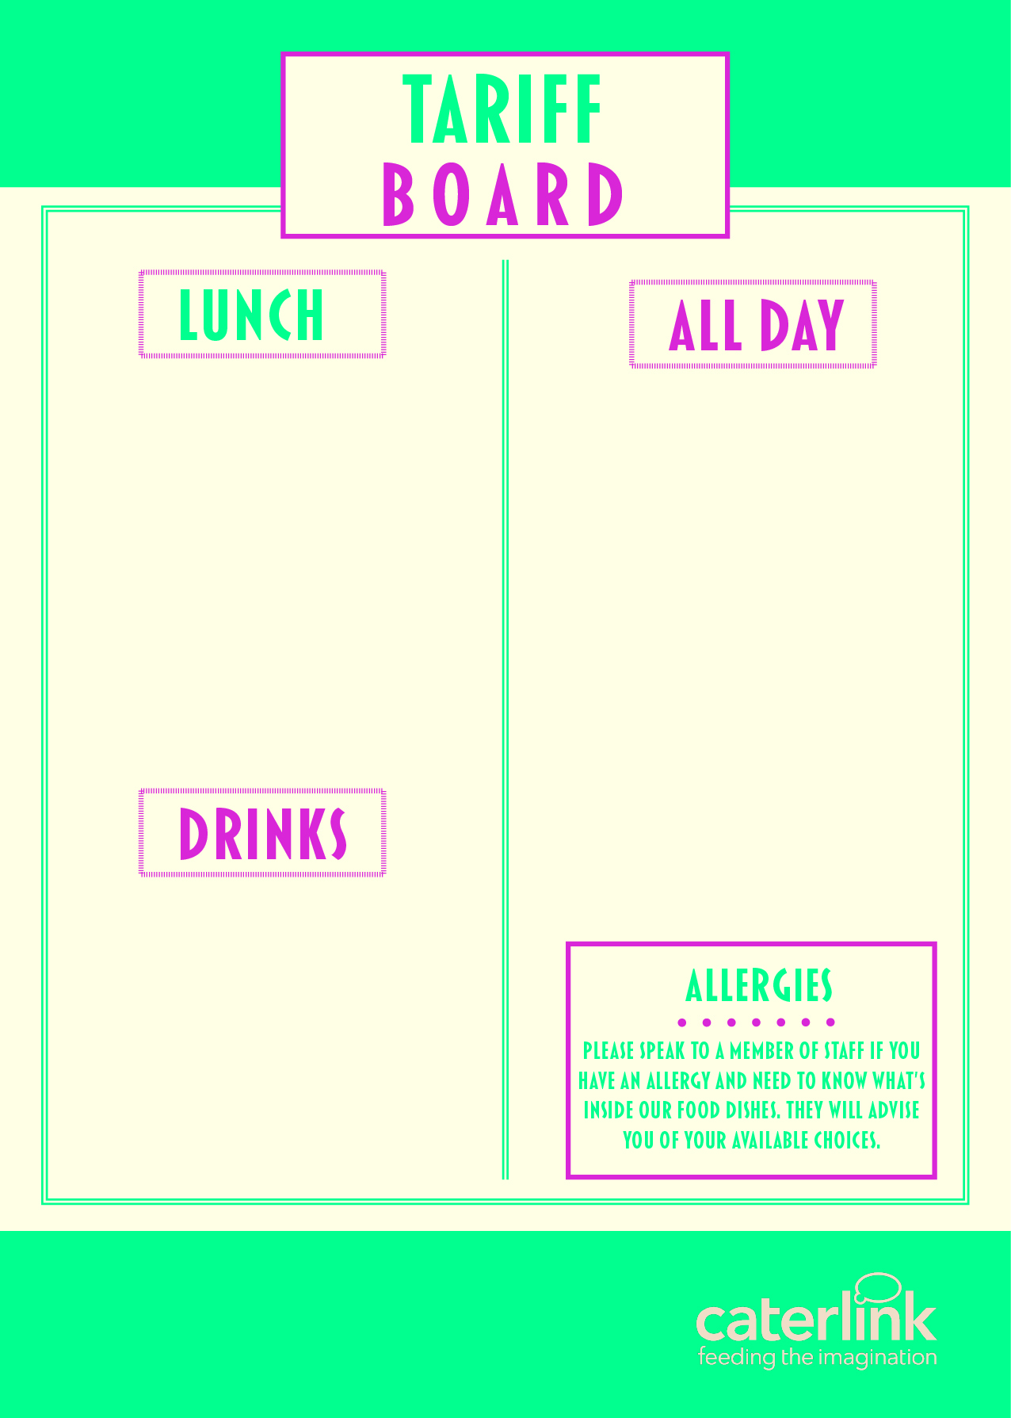
MAIN MEAL DEAL (FSM) (Main Meal & Dessert or Drink*) | £3.00
MAIN MEAL | £2.60
PIZZA SLICE | £1.55
JACKET POTATO & 1 FILLING ADDITIONAL FILLING | £2.10 £0.70
PASTA & SAUCE | £2.60
PASTA & CHEESE | £2.00
PANINI | £2.00
HOMEBAKE | £1.20
BAGUETTES - FROM | £2.30
PASTA / SALAD POTS - FROM | £1.50
FRUIT POTS - FROM | £1.20
SAUSAGE ROLL | £1.65
CHICKEN BURGER | £2.20
CROISSANT | £1.40
PAIN AU CHOCOLAT | £1.40
WAFFLE | £1.70
HASH BROWNS X 2 | £1.10
HOMEMADE ROLLS FROM | £1.65
POP CHIPS | £1.40
WATER – 500ml* | £1.00
RADNOR FIZZ | £1.45
VIVA MILKSHAKE | £1.15
JUICE BURST | £1.35
JUICE CARTON– 125ml* * Drinks are included as a Meal Deal option | £0.95

