Slide 1
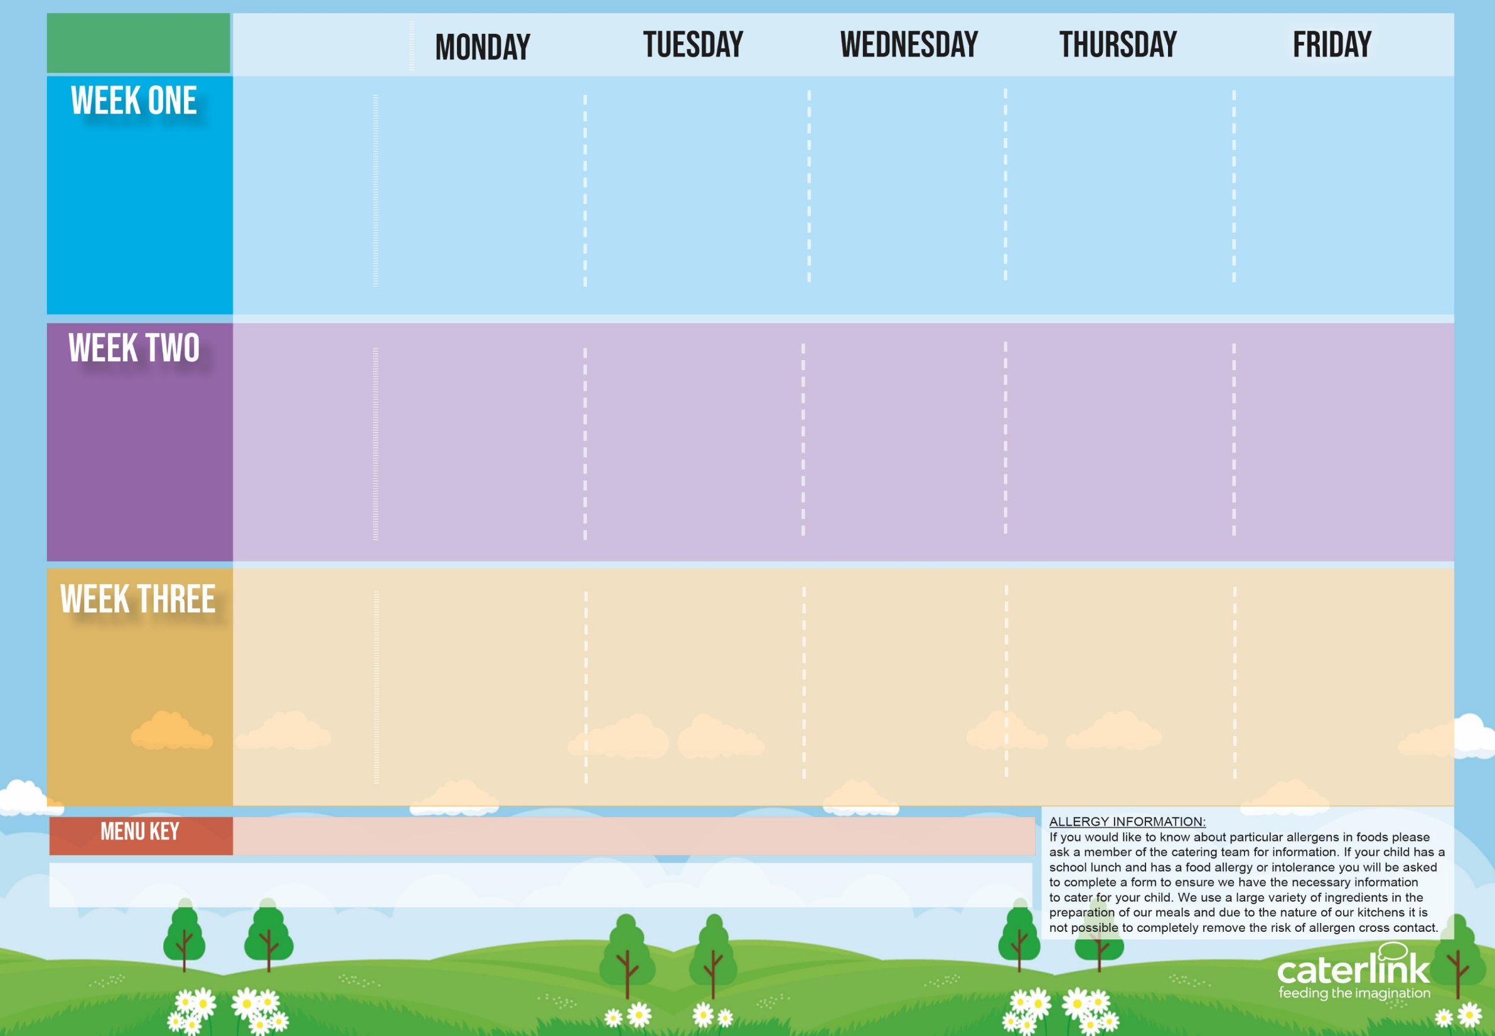







Autumn Winter
2025 2026
Option One
Option Two
Vegetables
Dessert
Beef Lasagne with Garlic Bread | Plant Balls in a Tomato Sauce With Rice | Roast Chicken, Stuffing, Roast Potatoes and Gravy | NEW Chicken Biryani | Fishfingers With Chips & Tomato Sauce
Autumn Vegetable Lasagne | Beetroot and Lentil Burger in a Bun with Potato Wedges | Vegetarian Wellington with Roast Potatoes and Gravy | NEW BBQ Sausage Pasta with Garlic Bread | Cheese and Bean Pasty with Chips and Tomato Sauce
Vegetables of the Day | Vegetables of the Day | Vegetables of the Day | Vegetables of the Day | Vegetables of the Day
Melting Moment Biscuit | NEW Apple Crumble Cake with Custard | Fruit Medley (no oranges) | Pineapple Drizzle Cake | Syrup Sponge with Custard
3/11, 24/11, 15/12, 19/1, 9/2, 9/3
Option One
Option Two
Vegetables
Dessert
Classic Cheese and Tomato Pizza with Wedges | Spaghetti Bolognaise | BBQ Chicken or Quorn with Seasoned Potatoes | Meatballs in Tomato Sauce with Rice | Fish Fingers With Chips
Mild Mexican Chilli with Rice | Vegan Spaghetti Bolognaise |  | Creamy Chickpea and Coconut Curry with Rice | Cheese Whirl with Chips and Tomato Sauce
Vegetables of the Day | Vegetables of the Day | Vegetables of the Day | Vegetables of the Day | Vegetables of the Day
NEW Gingerbread Cookie | Chocolate brownie | Fruit Salad (no oranges) | Sticky Toffee Apple Crumble with Custard | Chocolate Shortbread
10/11, 1/12, 5/1, 26/1, 23/2, 16/3
Option One
Option Two
Vegetables
Dessert
Macaroni Cheese(no oranges) | NEW Chicken Enchilada Bake with Paprika Wedges | Sausage with Roast Potatoes and Gravy | Mild Caribbean Chicken with Golden Rice Caribbean Stew with Golden Rice | Fishfingers with Chips & Tomato Sauce
NEW Chefs Special Lentil Curry with Rice | Tomato Pasta | Vegan Sausage and Roast Potatoes with Gravy |  | Red Pepper Frittata with Chips & Tomato Sauce
Vegetables of the Day | Vegetables of the Day | Vegetables of the Day | Vegetables of the Day | Vegetables of the Day
Oaty Cookie | Pear & Berry Crumble with Custard | Fruit Salad (no oranges) | NEW Jamaican Ginger Cake with Custard | Flapjack
17/11, 8/12, 12/1, 2/2, 2/3, 23/3
Added Plant Protein
Wholemeal
Vegan
Chef’s Special
Available Daily: - Freshly cooked jacket potatoes with a choice of fillings - Bread freshly baked on site daily- Daily salad selection – Fresh Fruit (no oranges) and Yoghurt

