Slide 1









The scientific way to study
Welcome to Tassomai
(pronounced Tass-oh-my)
Let’s get you started...

Slide 2

A smarter way to learn and revise
Tassomai is an online learning and revision platform that uses quizzing to test and teach.
“Within an hour I remembered more through Tassomai than I had with 10 hours of revision from a textbook.”
Michael, Year 10, Budehaven
The program’s smart algorithm:
Organises and spreads out your learning Personalises your content
Builds knowledge

Slide 3

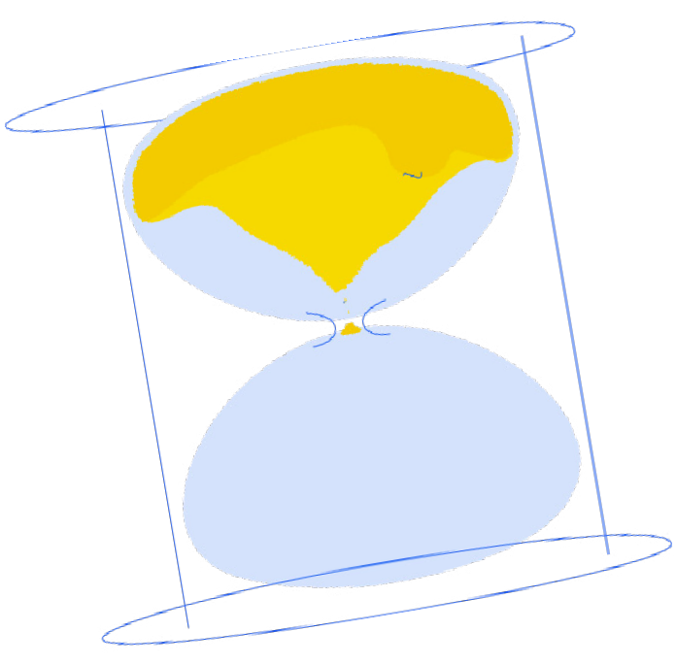
So why are we here?
This presentation covers: How to use the program Why it works
How to get started
It will only take about 10 minutes and then you’ll be ready to go!

Slide 4
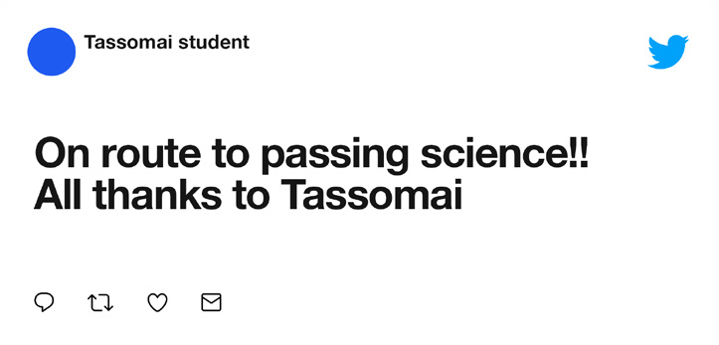
The science of learning
It’s why Tassomai works!
Did you know? … Researchers into revision and learning techniques found the best way to study and get knowledge to stick is:
Work for concentrated short bursts Regularly test yourself
Frequently switch between topics
Tassomai is designed to help you do all of these things.

Slide 5
Tassomai has helped 1000s of students get top marks in GCSE science!

Slide 6

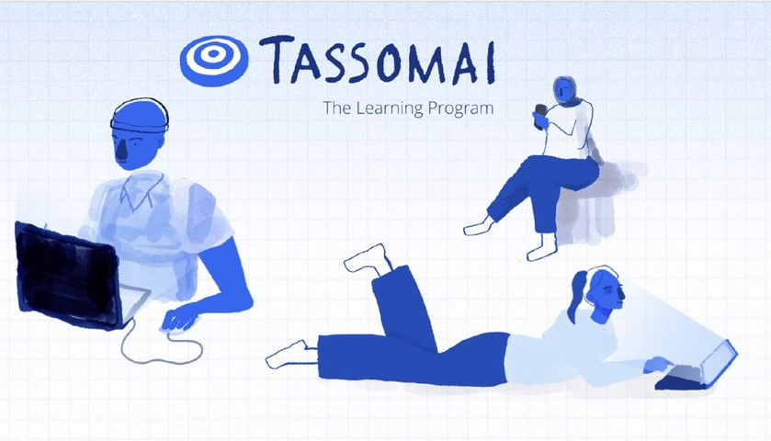

Ready to learn more?
Start by watching this video about how Tassomai works and then continue with the rest of the presentation to cover some important FAQs and learn how to get quizzing!
Click the image to watch!
Hey teachers! If you can’t open this link then you can find the video on the teacher hub or YouTube

Slide 7
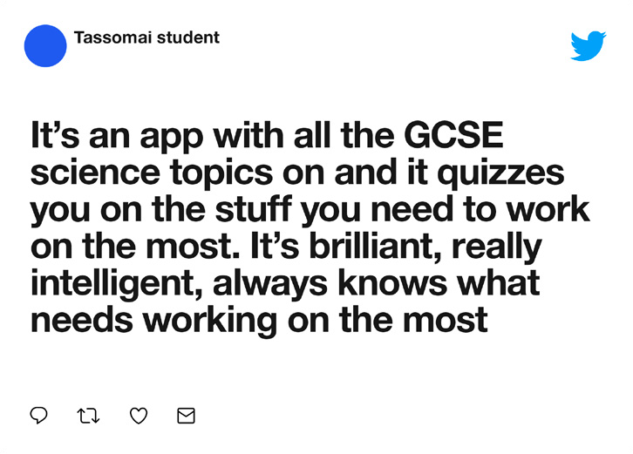
So what’s coming up in this presentation?
We’ll cover the following frequently asked questions:
“Can I choose which quiz I want to take?”
“Can I see the recent quizzes I’ve taken?” “What’s ‘the Tree’?”
“What does the information at the start of a quiz mean?”

Slide 8
We’ll cover the following frequently asked questions:
“How do I get my Daily Goal to go down?”
“Are there any videos that will help me learn?” “How do I get started?”

Slide 9







“Can I choose which quiz I want to take?”
Tassomai’s algorithm is working hard to figure out which quizzes you should be taking and it will give you a mix of different topics, which is proven to help learning.
This is why students need to do their Daily Goal BEFORE they can choose to take a quiz on a particular topic in the ‘Subjects’ tab.
Psst - Teachers do have control over this setting, so if they want to give you the option of choosing which quizzes you take regardless of doing your Daily Goal, they can do so.

Slide 10
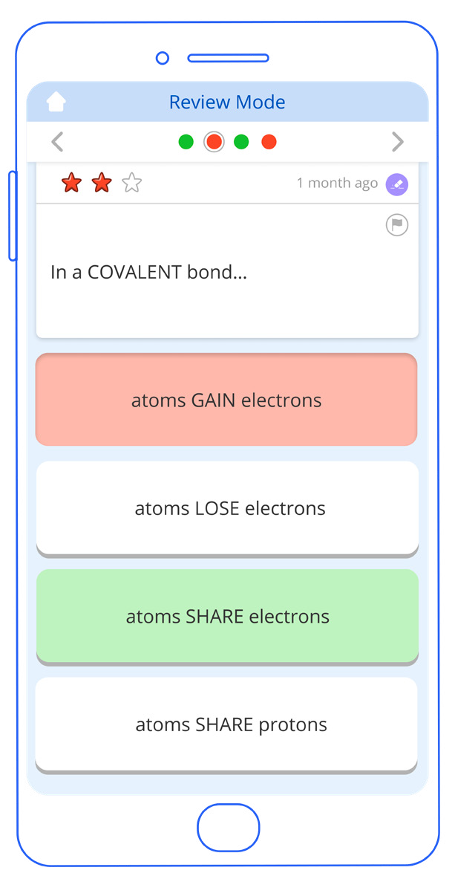

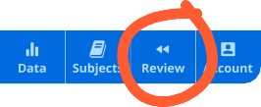


“Can I see the recent quizzes I’ve taken?”
Yes! You can see the last 10 quizzes you took and how you answered each question in the ‘Review’ tab. Going back over your answers can be really useful for revising tricky topics.

Slide 11
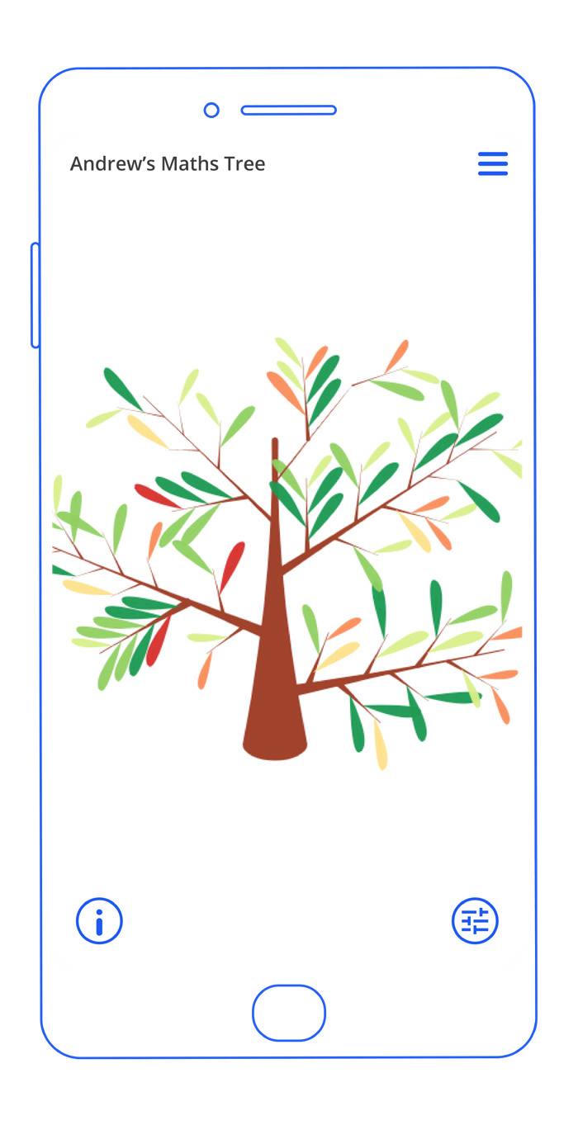

“What’s ‘the Tree’?”
The Tree is a visual representation of your knowledge. It’s personalised and will update in real time! Each leaf represents a Tassomai question (the branches represent topics), and the colour indicates whether you’re answering that question correctly or not.
By the way... If your school has parent reports set up, your parent or guardian will have access to your tree on their account too!

Slide 12
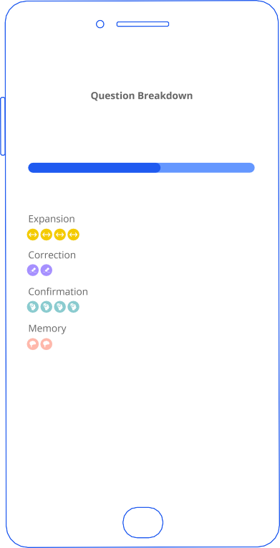





“What does the information at the start of a quiz mean?”
Tassomai is working hard to pick the perfect quiz for you. This is based on several factors (knowledge gaps, recent errors, exams date).
Before you take a quiz, you will be shown a ‘quiz profile’ and a breakdown of the types of questions your about to see, to give you more of an idea of the reasoning behind the questions you are receiving.
Psst! If you want to find out more about this, visit our blog here.

Slide 13

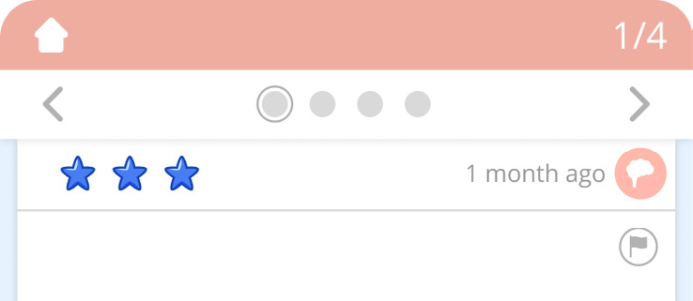

“What do the coloured stars on a question mean?”
The coloured stars show how you previously answered
a question.
If you get a question right three times in a row, you have ‘mastered’
it and it might be a little while before you see it again.
Mastered

Slide 14


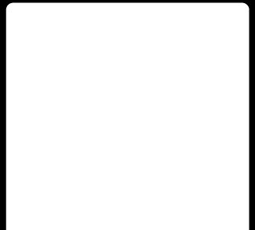





“How do I get my Daily Goal to go down?”
Do your Daily Goal today, and it will be lower tomorrow; fail to complete it tomorrow and it will go up a bit for the next day.
This makes completing your Daily Goal rewarding and motivating, and gives you the power to lower your daily workload.
The highest your Daily Goal can be is 40 and the lowest is 15.

Slide 15
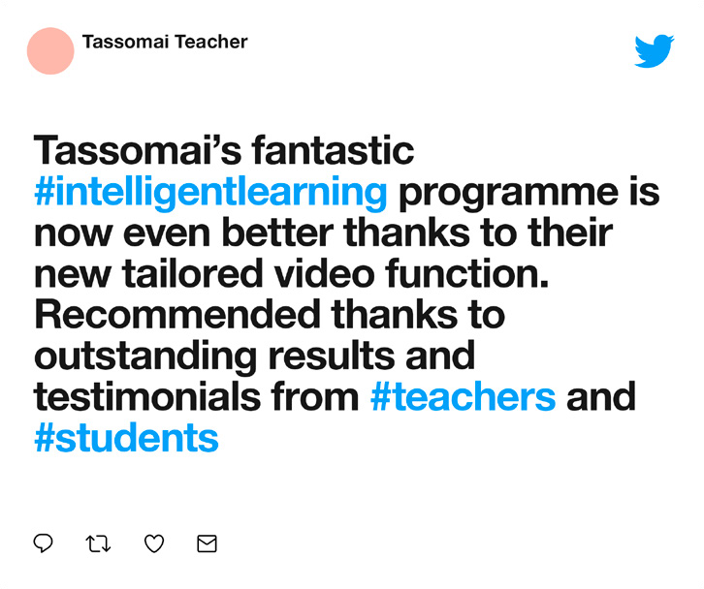
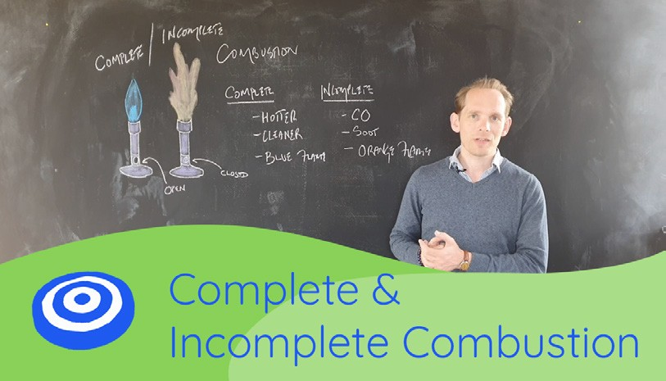
“Are there any videos that will help me learn?”
Yes! KS4 students will be shown short, targeted videos specifically chosen by our algorithm to help them with areas where they are struggling.
You can also watch these videos in your own time, to help you with learning or revision. Subscribe to our YouTube channel to get all our video content for free.
These videos are currently only available on science quizzes, but we hope to expand to other subjects soon!

Slide 16
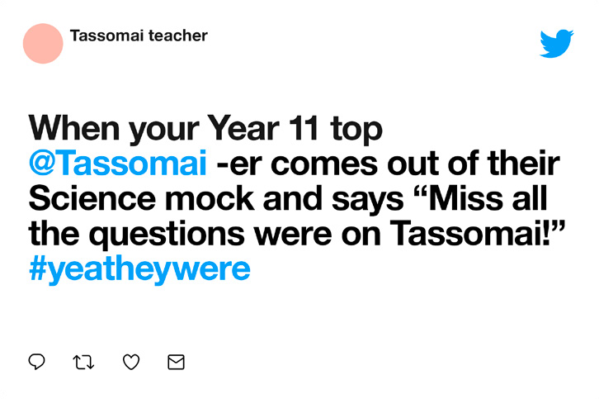
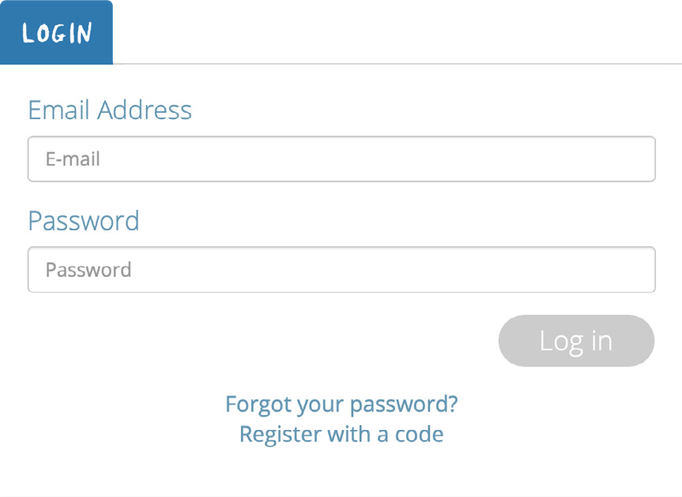



“How do I get started ?”
To get started, go to tassomai.com/login and choose ‘Register with a code’
Enter your school’s unique code – your teacher can give you this! Create your account by filling in the details and select the class that you are in from the drop down. Get quizzing!

Slide 17
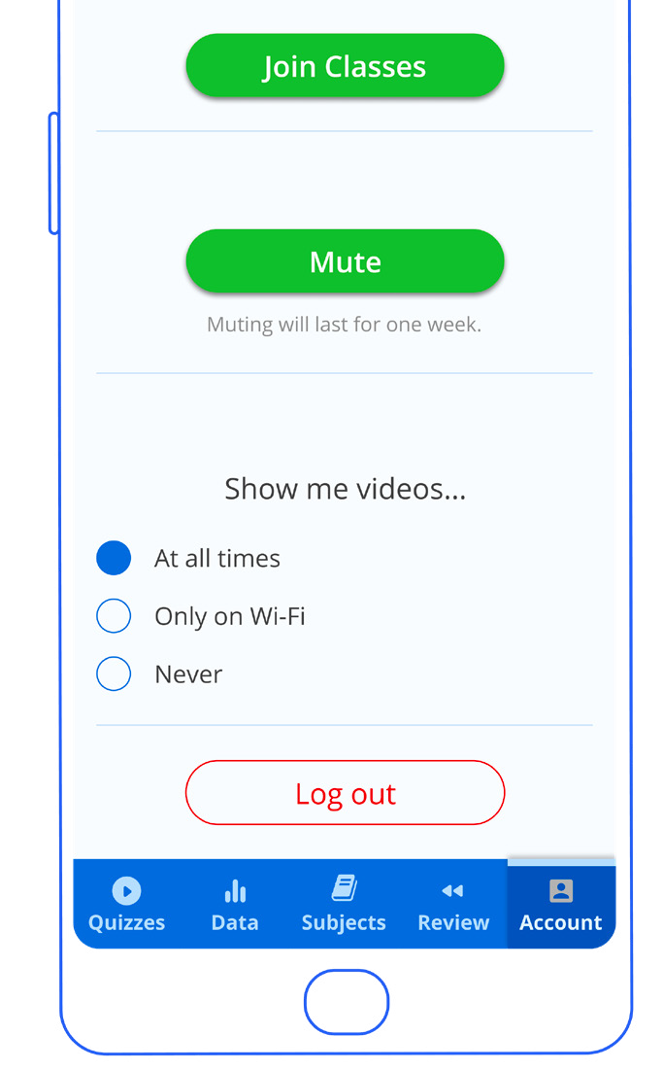

Using Tassomai for more than one subject?
Simply create your account and select any one of the classes that you are in.
Once you ‘ve done this you can then go to your settings and select ‘Join Classes’ to choose the remaining groups that you need to be in.
TOP TIP: once you have joined a class, you can’t leave it (your teacher has to remove you) so make sure you select the correct class!

Slide 18
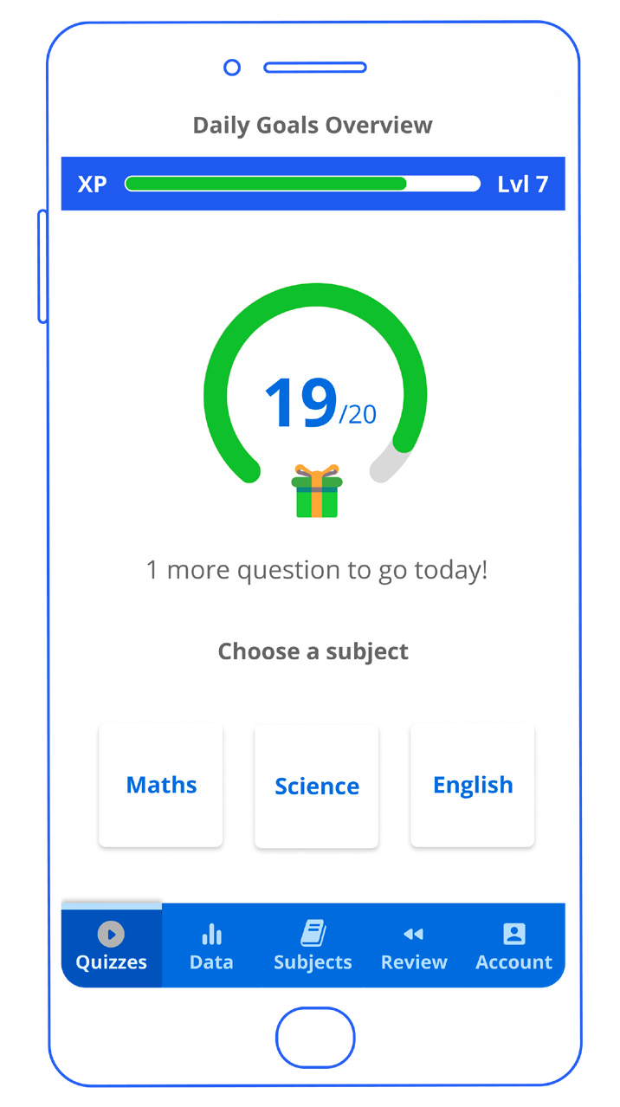
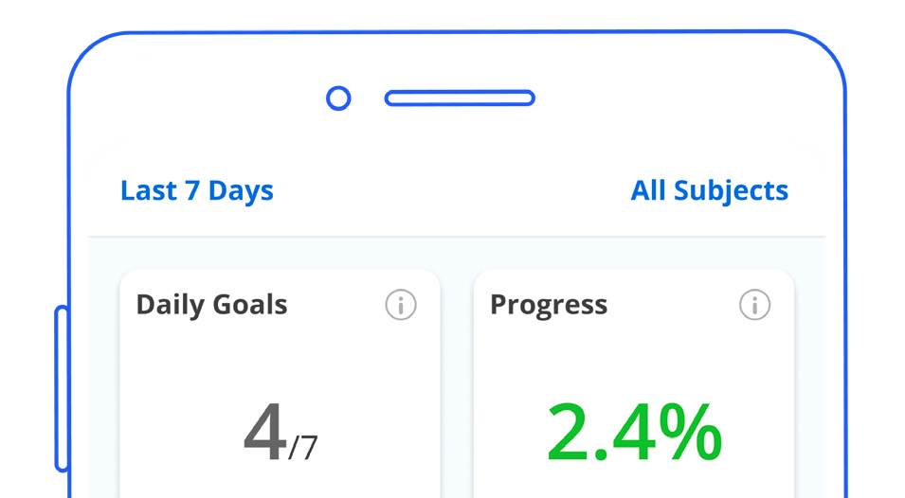
Hitting your Daily Goals
You will have a Daily Goal for each subject and a ‘Combined Daily Goal’ which shows the total number of questions you need to answer correctly across all subjects.
It’s up to you which subject to tackle first!
When you look at the data tab you will be able to ‘filter’ the information to show your usage in each subject, or across all subjects.

Slide 19
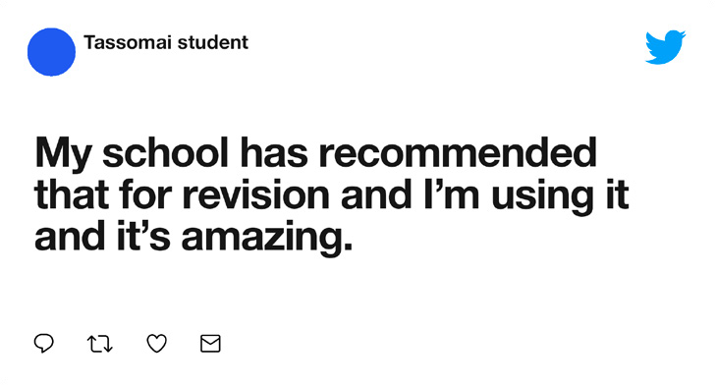
Let’s Be Friends!
We’ve covered the basics, but if you have any other questions email us at admin@tassomai.com
We’re also on Instagram, Facebook and Twitter – just search Tassomai and give us a follow to stay up to date with new releases and updates.
And don’t forget to subscribe to our YouTube channel for free revision content.

Slide 20
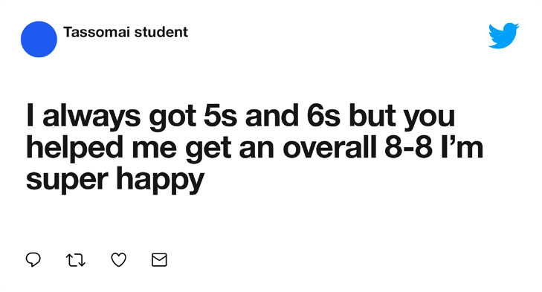

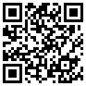


Using Tassomai on the go
The Tassomai app makes it easy to do your Daily Goal on the go.
Download the app now by scanning this QR code.
The app uses minimal data, and if you’re not on WIFI you can turn videos off to save data.

Slide 21
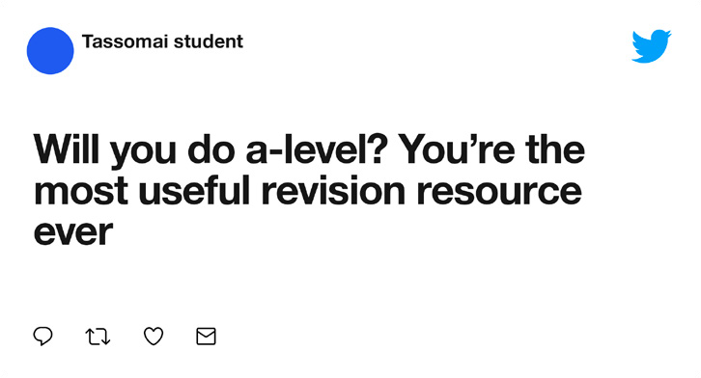
Thanks for watching!
Don’t forget:
Create your account Download the app
Subscribe to our YouTube channel Follow us on socials
Get quizzing!

